Slide 1
Title
Francesco Bogliacino

Slide 2
Lecture 1

Slide 3
Who am I and why this course

Slide 4
Let’s start
Things to do: start a project, key information
Documentation is very important so make sure that you add title, description, and that you created a GitHub or OSF file (you may also create the Github folder and link to an OSF project via adds-on Github, choosing one folder)
Learning about some basic tabs:
Folder to upload static files
Html
Css (we will see later)

Slide 5
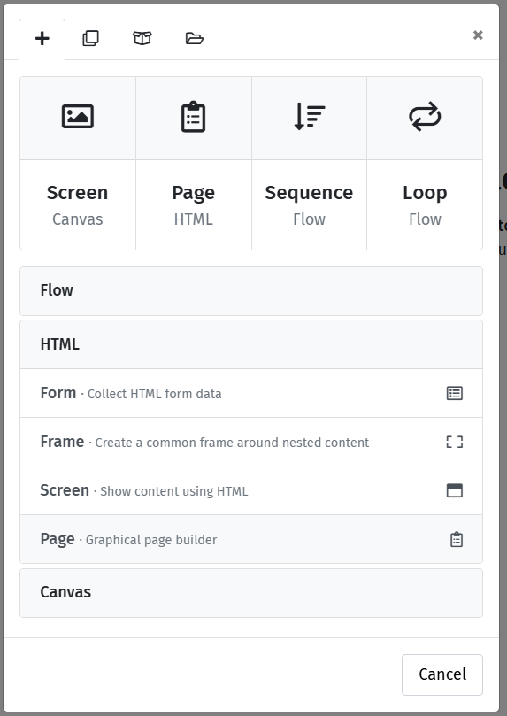
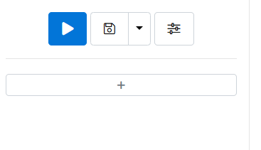
Start by a basic form
You will be asking questions. The way a web interface collects response is through a form
To introduce a form,

Slide 6
The first form
We will ask two simple questions: gender and age.
But this will be our way to learn a bit about html and css
First give a name to the form

Slide 7
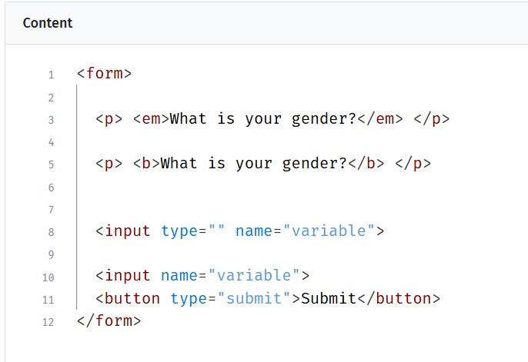
The html
Html is a markup language. You do not perform tasks and operation. It is focused on presentation;
The key concept is tag a tag is open and closed like. Italic and bold are controlled as tags

Slide 8
The input tag
The key tag to collect data for us will be the input tag;
The input element does not require a closing tag because it is used to create various types of form controls, such as text fields, checkboxes, radio buttons, and buttons;
There are plenty of types, so let’s learn about a few of them that are useful (https://www.w3schools.com/html/html_form_input_types.asp)

Slide 9
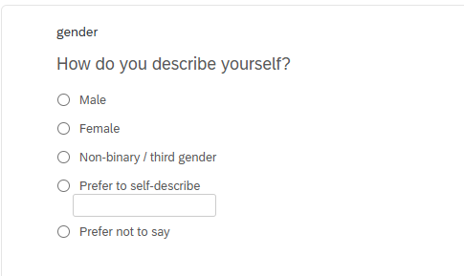
The gender question
We follow the Qualtrics validated question. We need five radio buttons and one text

Slide 10
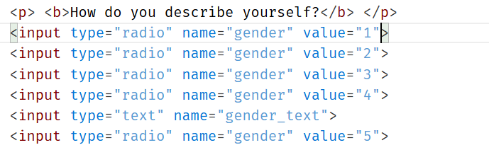
The gender question
We follow the Qualtrics validated question. We need five radio buttons and one text
Three problems
Required response
Formatting
Labels

Slide 11
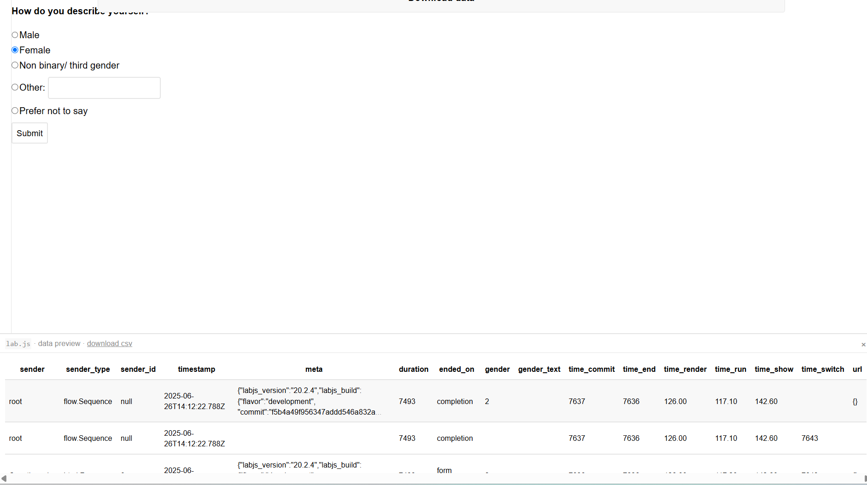
Let’s try to answer and look at the data

Slide 12
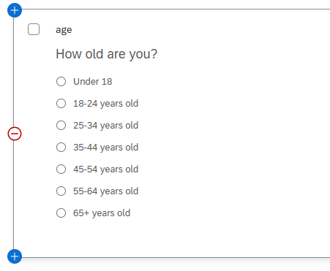
The age question
Try to implement the same question

Slide 13
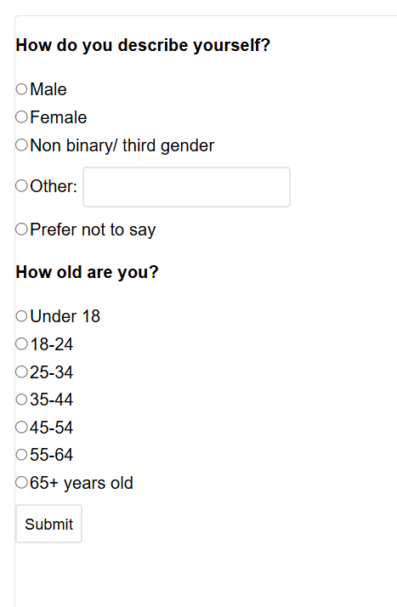



The interface is terrible

Slide 14
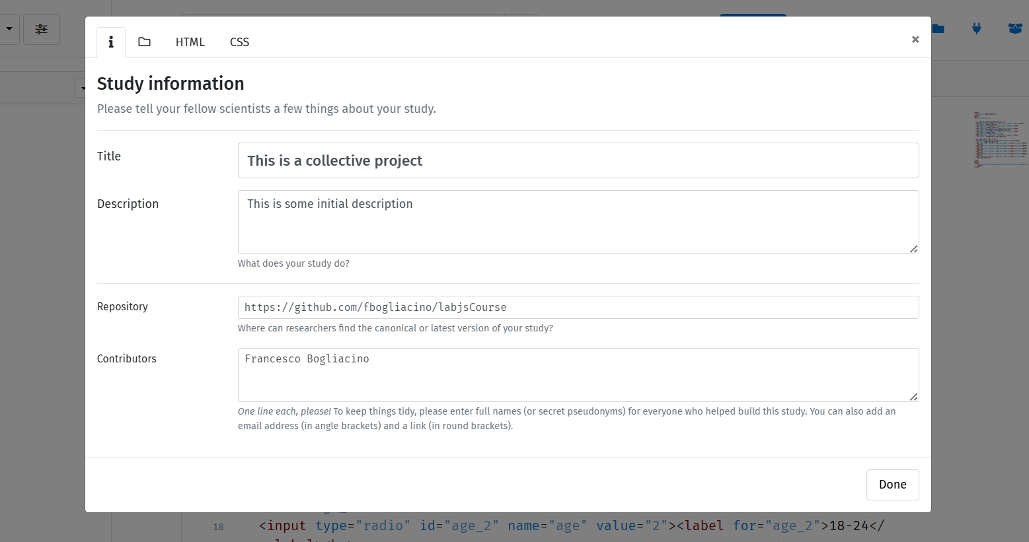
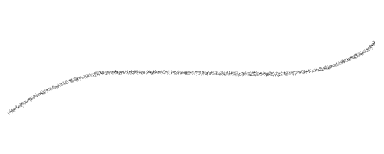


How to work in style
Notice that there is a baseline html

Slide 15

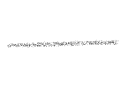












How to work in style
The key is the use of CSS. CSS is a programming language
You can typically define tags and classes in CSS
Play with some simple properties
main{
margin-left: 510px;
margin-right: 200px;
background-color: whitesmoke;
text-align: justify;
}

Slide 16
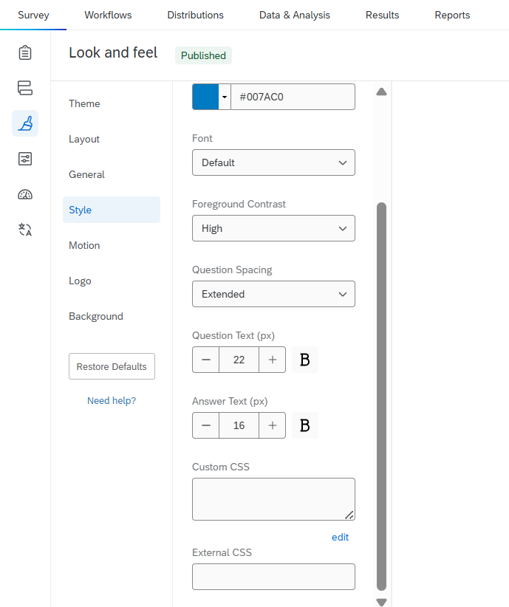




Notice: Qualtrics
You can use CSS to customize in most of experimental softwares, from Qualtrics to JATOS, from oTree to …

Slide 17
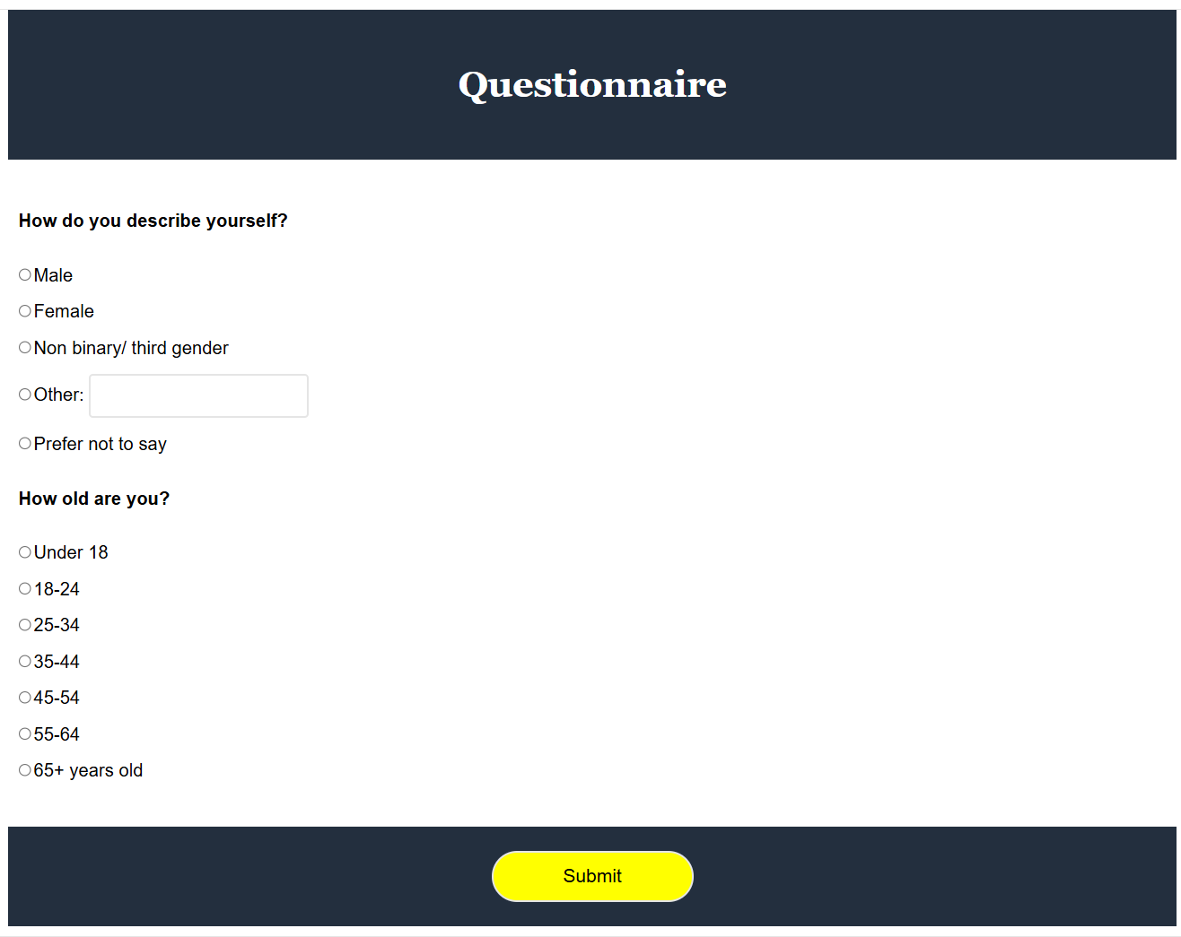

Slide 18
Lecture 2

Slide 19
Some basic stuff before coding seriously
There is a typical step you will need before starting: the informed consent
The basic ingredients of an informed consent are text and checkbox
Try a few minutes to work it out

Slide 20
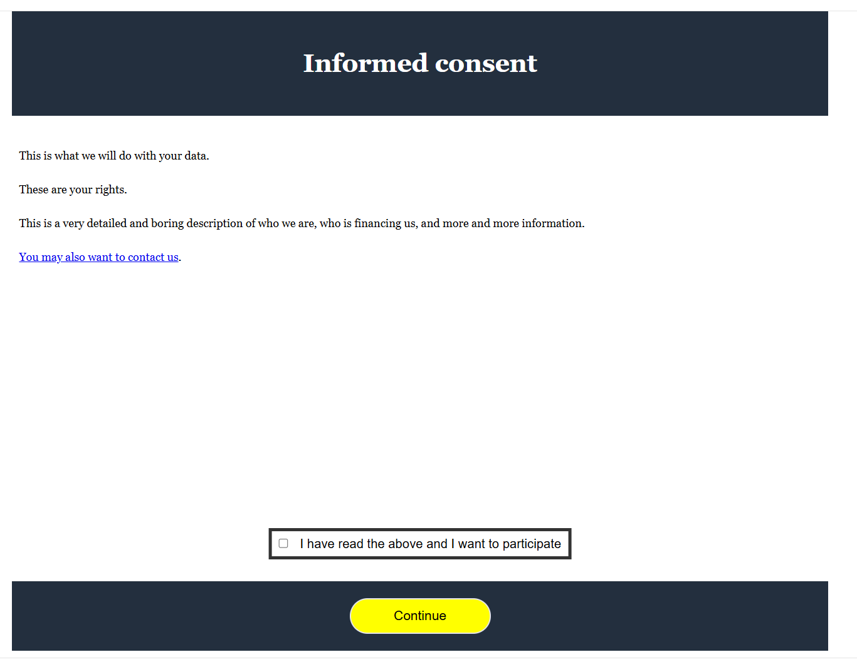
Informed consent
Remember the email contact
Check the css code

Slide 21
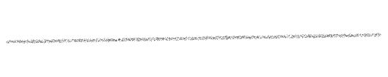
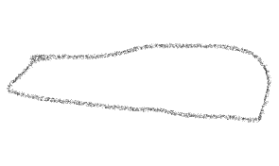
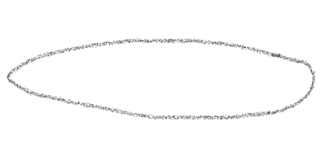
<header>
<h1 class="h1">Informed consent<h1>
</header>
<main>
<form id="informedConsent">
<p class="paragraph"> This is what we will do with your data. </p>
<p class="paragraph"> These are your rights. </p>
<p class="paragraph"> This is a very detailed and boring description of who we are, who is financing us, and more and more information. </p>
<p class="paragraph"> <a href="mailto:someone@example.com">You may also want to contact us</a>. </p>
<div class="myContainer">
<input type="checkbox" id="checkbox" name="consent" required> <label class="labelInputs" for="checkbox"> I have read the above and I want to participate </label>
</div>
</form>
</main>
<footer>
<button form="informedConsent" class="continueButton" type="submit">Continue</button>
</footer>

Slide 22
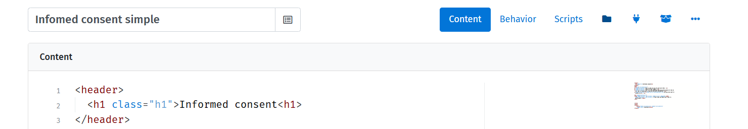

Informed consent
This format is not flexible enough (what is the IRB asked us to use a two pages IC?) and already contained too much text;
We can use the iframe tag, which allows embedding a document within the document

Slide 23
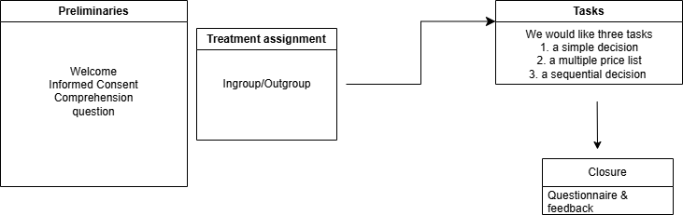
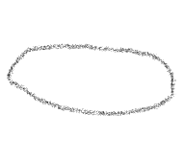
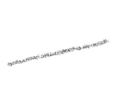









Now let’s pause for a moment
What do we want to do?
randomization
Single switch
matching
Feedback & controlling attempts

